Slide 1
READING A RENT HISTORY
What is a rent history,
why should we get one
how can you get one,
and what does it mean?

Slide 2
What is a rent history?
Landlords of rent-stabilized units are supposed to register the legal regulated rent every year with HCR.
A rent history is supposed to show the history of those rents reported to HCR all the way back to 1984.
However, there is lax enforcement:
Rent registrations are self-reported
HCR does not check if the landlord is reporting
There is no fine for not reporting
Some rent histories are incomplete or fraudulent

Slide 3
Why Get a Rent History?
Important tool for learning about your status as a tenant
Are you rent stabilized?
Your landlord will not know that you have requested your rent history
New knowledge could affect your circumstances
I found out that I had a preferential rent that was not disclosed
My legal regulated rent is double the rent that I’ve been paying
Knowledge empowers to take action
My own thinking about the importance of being a rent regulated tenant and my active role in the movement
Are you being overcharged?
Whether MCIs and IAIs properly applied?
Where is your lease in relation to the deregulation rent threshold (DRT)?
Look back to previous years and adjust legal regulated rent

Slide 4
Sources of Rent Increases
Rent Guidelines Board Increases
Loft Order
https://www1.nyc.gov/site/rentguidelinesboard/rent-guidelines/2018-19-apartment-loft-order-50.page
History of Rent Increases
https://www1.nyc.gov/assets/rentguidelinesboard/pdf/guidelines/aptorders2018.pdf
Vacancy Increase
MCIs and IAIs
Preferential Rent

Slide 5
Resources and Terms
Deregulation Rent Threshold (DRT)
Current DRT is $2,774.76, as of January 1, 2019
Financial incentive for landlords so they can deregulate the unit
Legal Regulated Rent
The max rent that a landlord charge for a rent-stabilized unit
Preferential Rent
A rent that is lower than the legal regulated rent in a rent-stabilized unit

Slide 6
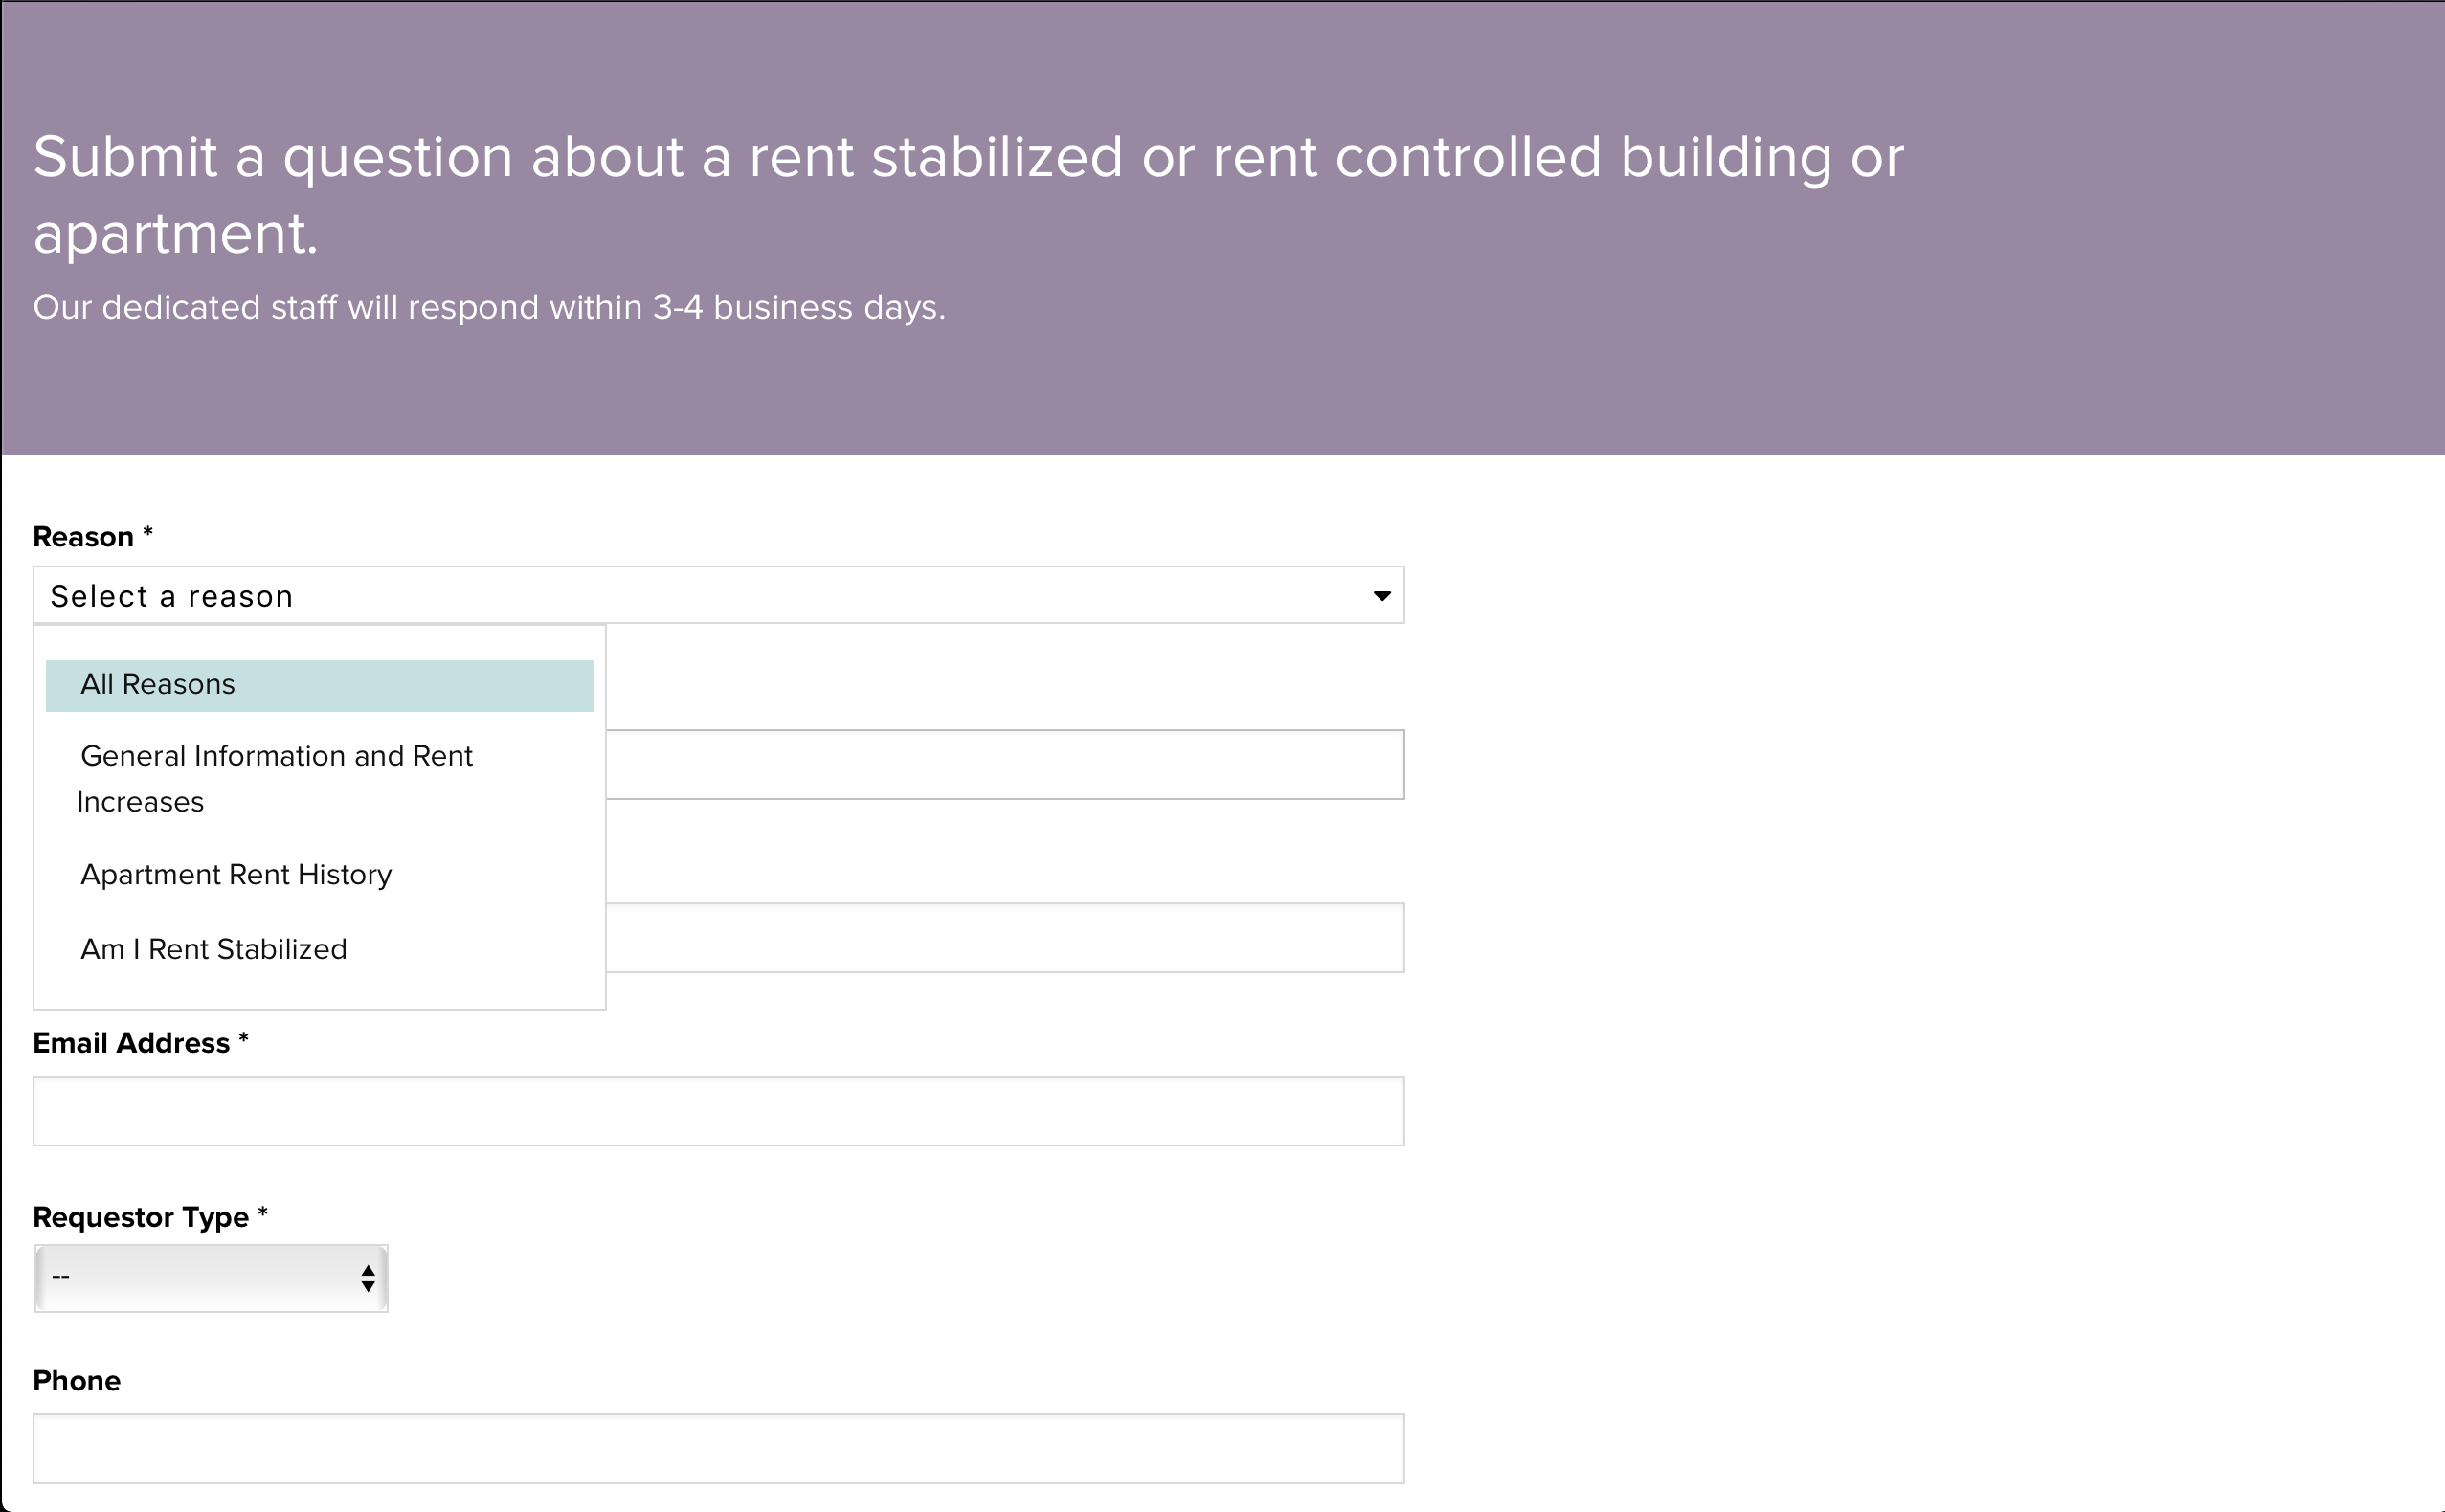
Requesting Your Rent History
Notes:
https://portal.hcr.ny.gov/app/ask

Slide 7
Rent History Terms
RS = rent stabilized
VAC/LEAS = vacancy lease
LEAS/RNL = lease renewal
PREF RENT = preferential rent
(A) = indicates that an amendment to the annual apartment registration was filed by the owner

Slide 8
A Rent History
Amendments: 2003-2005
April registration deadline
Large rent increase from: 2004-2005
Owner occupancy and MCI: 2005
First preferential rent: 2007
Reset preferential rent: 2012-2013
Legal registered rent is above decontrol rent threshold: 2013
However, the unit is still registered as rent-stabilized unit

Slide 9
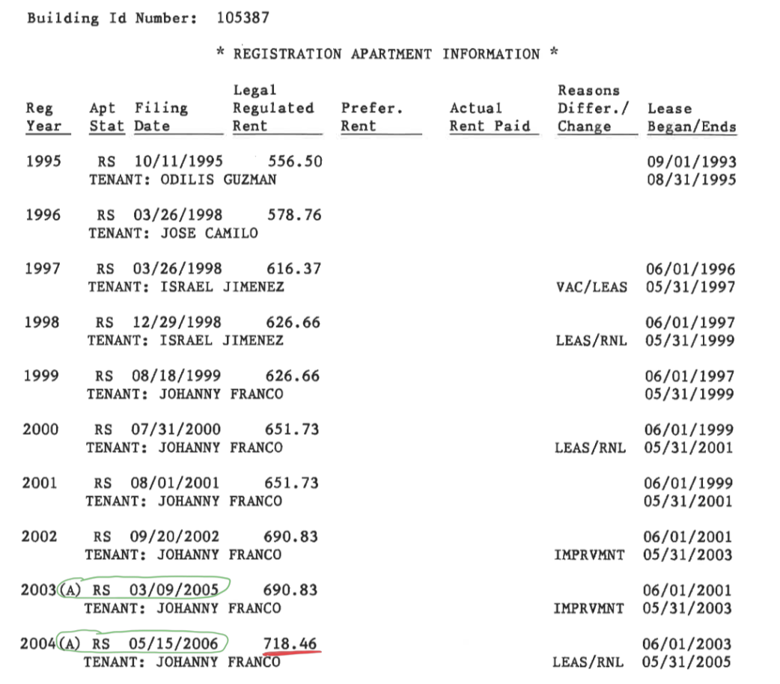

Slide 10
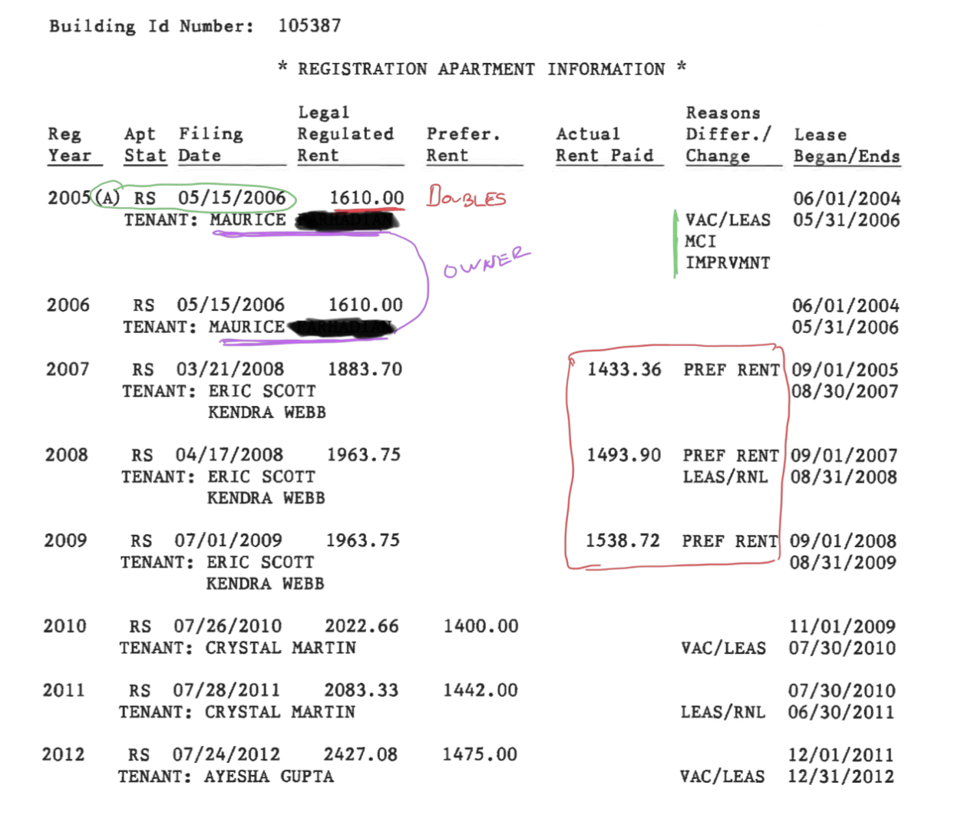

Slide 11
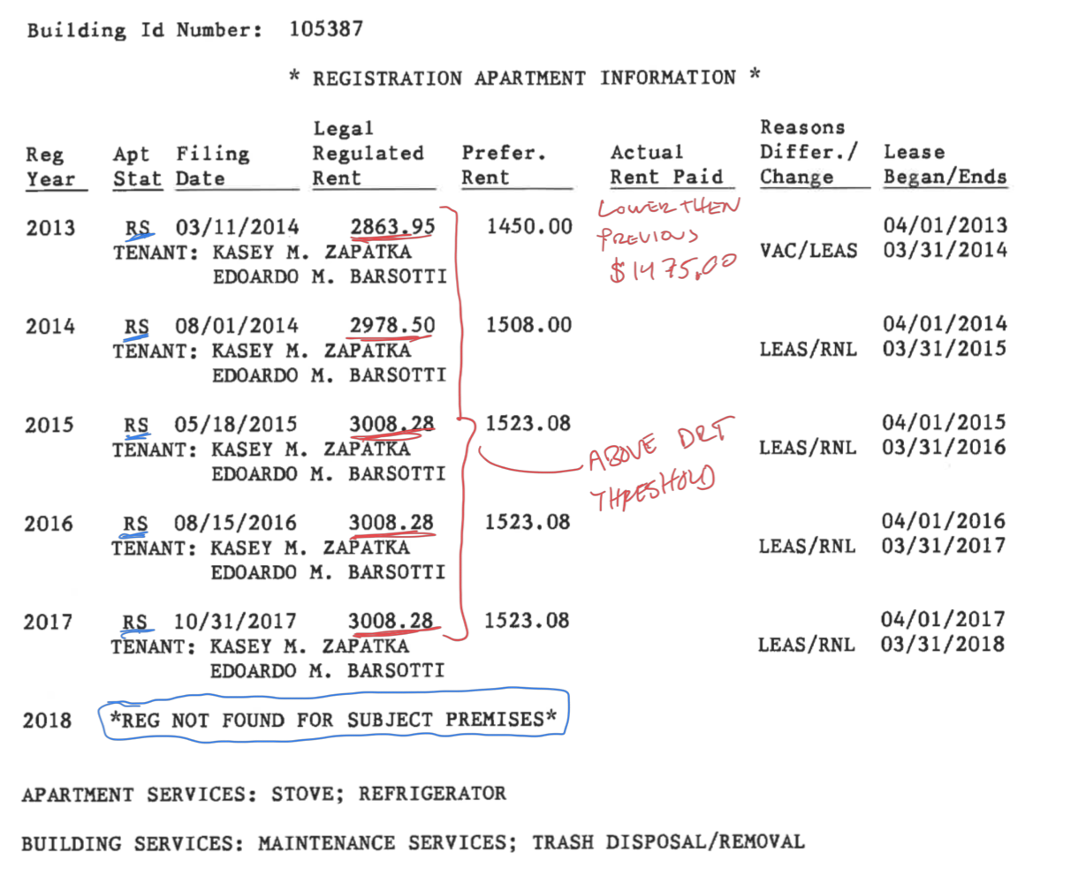

Slide 12
Conclusions
Currently live in a rent-stabilized apartment that is registered as having a legal regulated rent well above the deregulation rent threshold and a preferential rent
No disclosure of preferential rent on lease, so my preferential rent is my legal rent
Unit is theoretically subject to de-control because it is past the stature of limitations
Rent more than doubled from 2004-2005, which is unaffordable for most tenants

Slide 13
Takeaways
Important to know your rent history
Getting your rent history is the first step towards Housing Literacy
There are many possible scenarios and it’s important to know where you actually stand
Collective solidarity and individual protection

Slide 14
Resources
Housing Literacy
https://housingliteracynyc.org
Accessing your Apartment’s Rent History
https://portal.hcr.ny.gov/app/ask
Fact Sheet #40: Preferential Rents
https://hcr.ny.gov/system/files/documents/2018/09/orafac40.pdf
Current Rent Guidelines Board Increases
https://www1.nyc.gov/site/rentguidelinesboard/rent-guidelines/2018-19-apartment-loft-order-50.page

